Slide 1
Service Now Code Walk-thru
Udemy 201 ServiceNow Developers Project (“Fetch”)
Trying to research/explain how & when the Instructor knows what function calls and what parameters are available without any assistance from the IDE.
https://www.udemy.com/servicenow-201-development/learn/v4/t/lecture/7333996?start=947

Slide 2
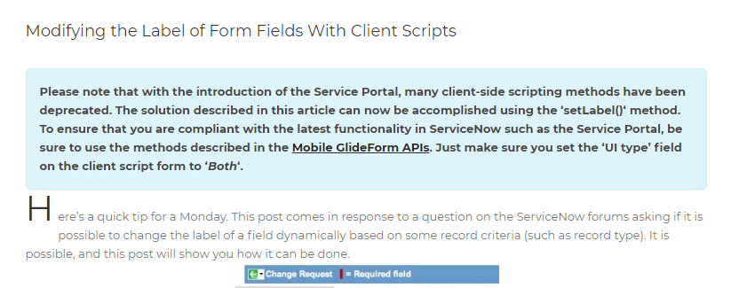
NOTE: Regardless of where the Tutorial Notes are coming from, there seems to be some consensus about insuring Client Side Scripts are set to “Mobile” platform.
Apparently this is always the most recent / least-deprecated version of APIs available.
Both the Udemy class and this SNGuru site seem to agree:
https://www.servicenowguru.com/system-ui/ui-scripts-system-ui/modifying-label-form-fields-client-scripts/#

Slide 3
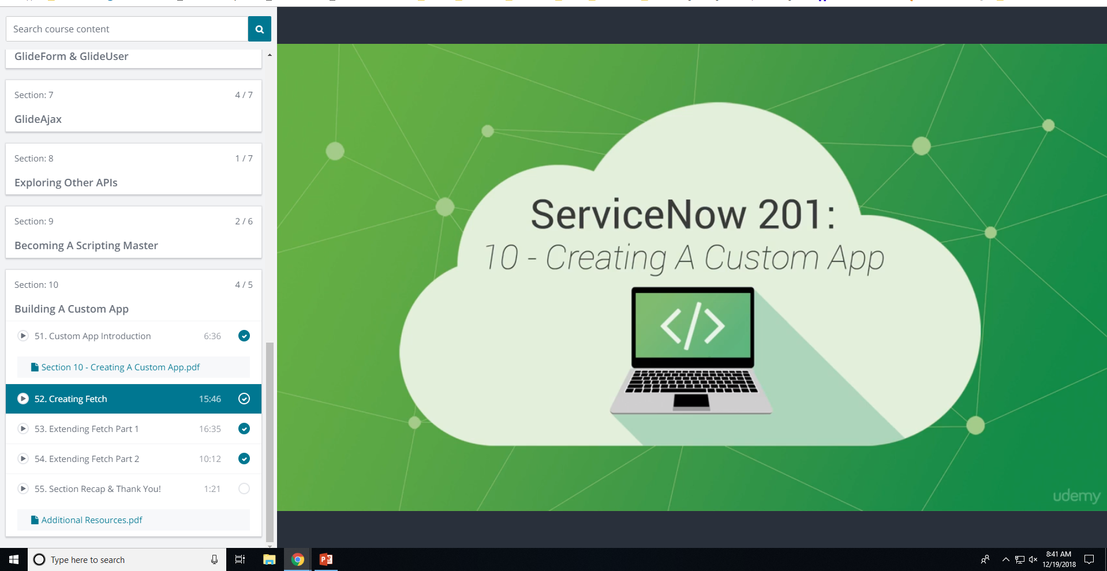
This is the Udemy online Class that contains the Custom App Tutorial “Fetch”
In this section, the Instructor is moving a brisk pace and does NOT have any explanation nor provide any insight for how he knows which parameters and which functions are available from among the many different editors/ide fields
The Goal is to attempt to research and comment on how the Instructor knew which functions/fields are available etc etc….
https://www.udemy.com/servicenow-201-development/learn/v4/t/lecture/7333996?start=947

Slide 4
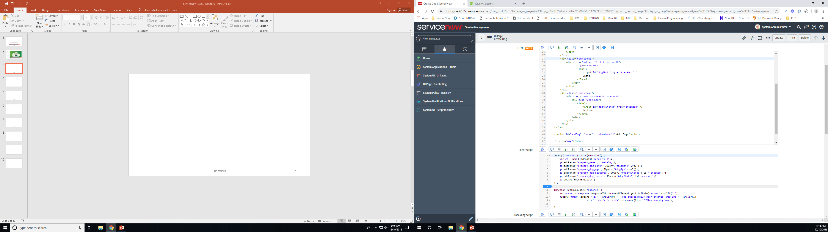
UI Page -- “Create Dog”
Using Jquery to create button click handler
Lookup the ID via “#<id of element>”
Jquery standard for id lookup is the ‘#’ char
Jquery Button Click handler is also
Using the GlideAjax API…
It’s loading up “Params” with semi-custom name / value pairs. It’s “Semi” because each parm MUST START with “sysparm_”
ga.addParam( “sysparm_Key”, “Value”)
These are used in other IDE Editors
Like Script-Include (etc.)
We are supposed to know about response.responseXML.documentElement.getAttribute
It’s discussed in earlier Tutorial Section on APIs…

Slide 5
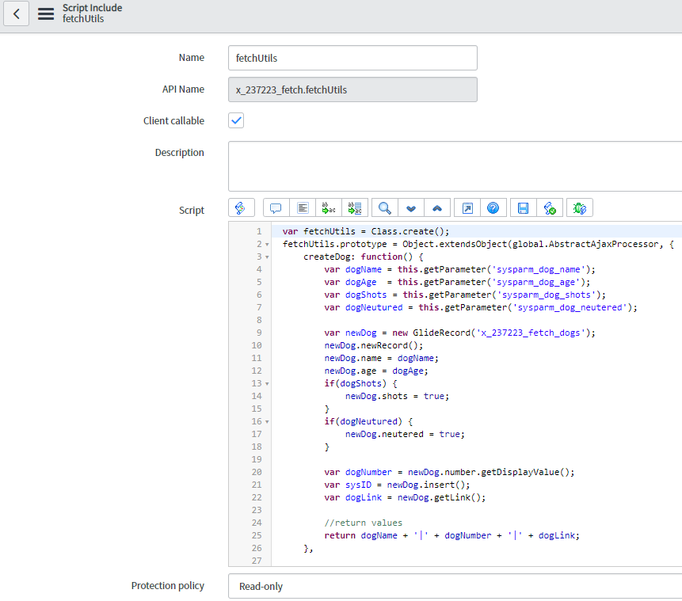
UI-PAGE….
SCRIPT-INCLUDE are Server-Side Only JavaScripts
But they CAN be called by Client-Side (requires AJAX)
SCRIPT-INCLUDE…
So, here we are pulling out Parameters..
With the custom names… that were assigned in the UI Page’s Client Script Section.

Slide 6
UI-PAGE….
So the UI-PAGE client-script is making an AJAX Call….
So there must be a RESPONSE returned….
Hence the apparent need for the function ‘fetchBallback’
A cute-name (apparently) for the Instructors ‘callback’ handler
Apparently this returns the HTML ‘pop up’ that we see after clicking the button.
Note, the response has a XML-related property
And the GlideAJAX has a ‘getXML’ function
So ServiceNow AJAX returns XML and not JSON ??
We also can see that there is somehow an attribute called “answer” and that somehow it contains a string delimited via ‘|’ pipe character.. (See Next Slide for Under-The-Hood view of the XML Response)
If we take a closer look at the SCRIPT-INCLUDE for ‘fetchUtils’..
We see that it’s Script Body returns a “|” delimited String…
Notice that when we create the GlideAjax object.. We are passing it the name of the ScriptInclude that we want to create. It’s name matches the ScriptInclude we know about.. We can conclude that ‘answer’ must be an Auto-Magically defined ATTRIBUTE within the XML RESPONSE that is always returned via any ScriptInclude call …
(at least ones with the Client-callable checkbox enabled)

Slide 7
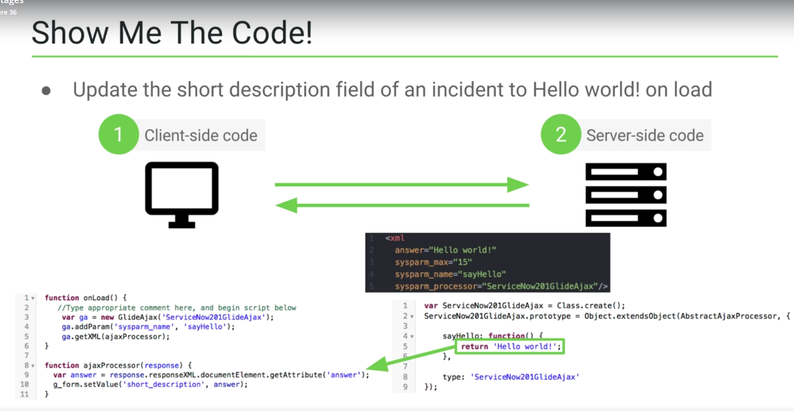
https://www.udemy.com/servicenow-201-development/learn/v4/t/lecture/7390440?start=0
(at approximately 2:45 into the lesson, the following slide is displayed showing ‘answer’ element
NOTE: 2 param names are REQUIRED AS-IS
sysparm_name
sysparm_processor

Slide 8
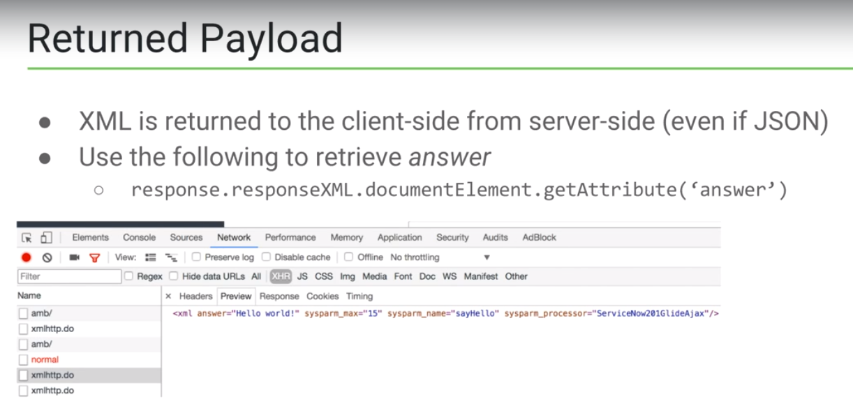
You can use the Developer Console of your Browser to inspect the Response…
sysparm_name was created by the original REQUEST
But it’s include din the RESPONSE to insure you can match up the proper response / request data

Slide 9
The following Slides are screen shots of the Udemy project..
With annotations of my notes added directly to the project as comments..

Slide 10
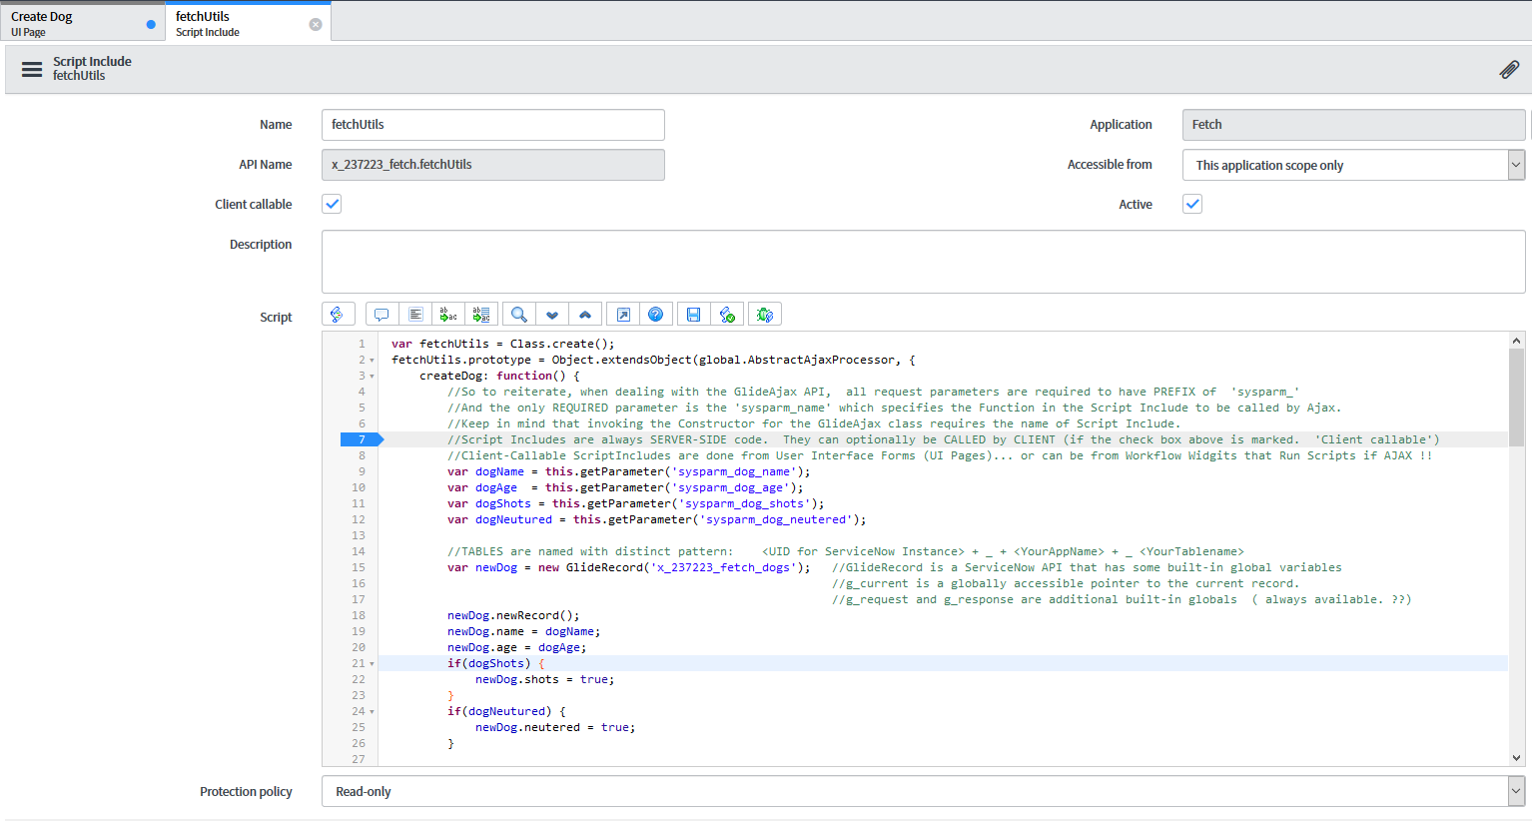
Server Side (Script-Include) .. With
Notes added as Comments to provide
Additional clarity about the APIs etc…

Slide 11
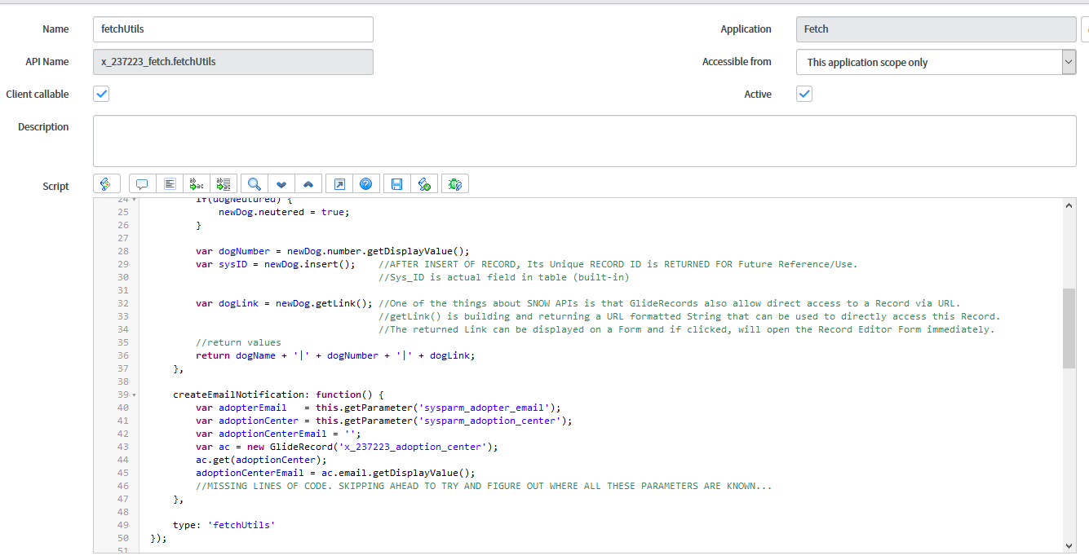
Script-Include continued..

Slide 12
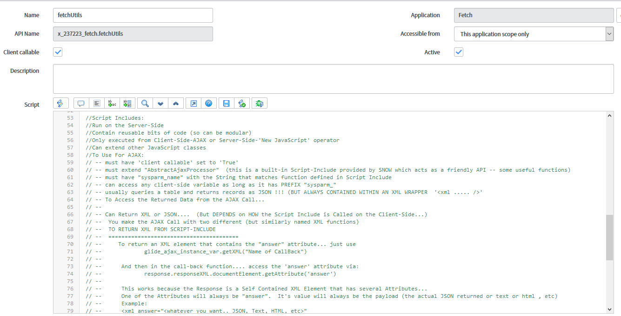
Script Include continued…..

Slide 13
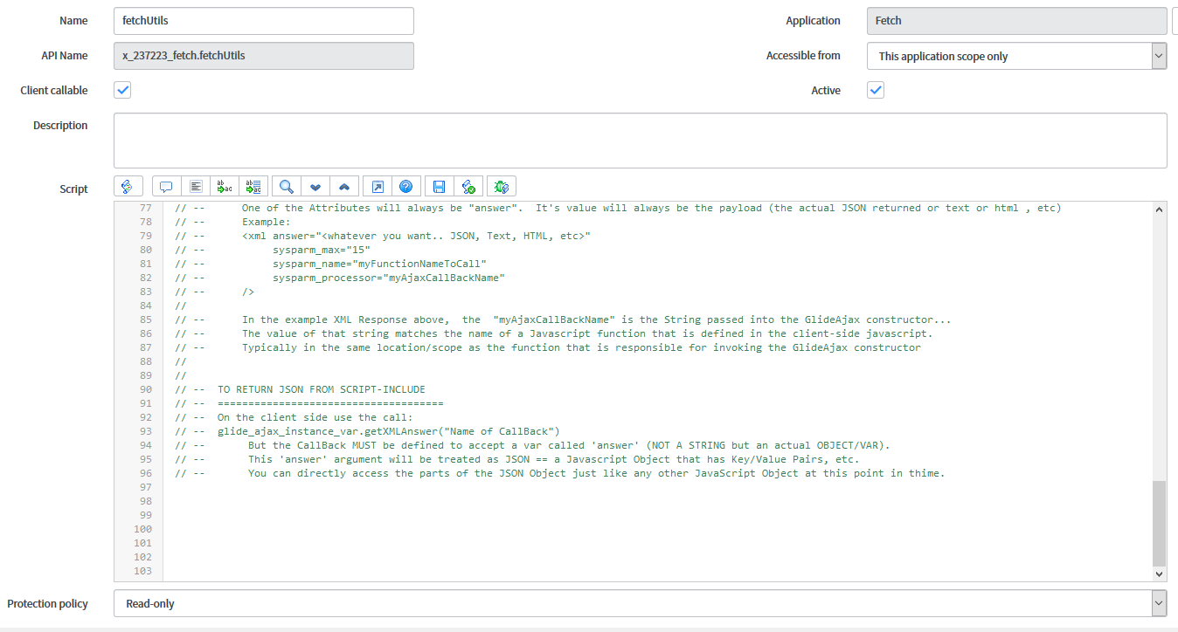
Script Include Final slide

